Slide 1

The Visits
and Borrowed Books from Libraries in York
By
Samuel Ko
Topic of Art & Culture

Slide 2

Over View Of The Project
Select a topic about “Art & Culture” from the government dataset, downlow the dataset from below link:
https://www.data.gov.uk/dataset/64a319b3-c925-4224-9f60-e0b31fb44149/performance-indicators-art-and-culture
The dataset captures the data about people visit and borrow books from the libraries near York in the period 2012 - 2023

Slide 3

Problem Statement
By studying the dataset with using Python, Pandas and SQL, the utilization of the libraries near the York area will be investigated in order to understand the culture in UK (York area).
The situation of the service usages over the study period will also be visualised by the Power BI Desktop.

Slide 4
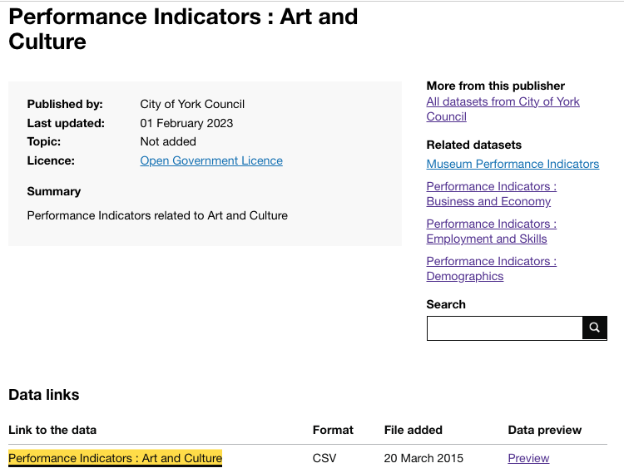

Collecting Data
kpi-art-culture-original.csv

Slide 5

Meta Data
File Name : kpi-art-culture.csv
Title : The study of culture life in York/UK (Visiting library and Borrow Books)
Data Available : April 2011 - Feb 2023
Publisher : York Council, UK
Coverage Spatial : Quarter 1, 2, 3 and 4
Type : Administrative
Language : English
Source : https://www.data.gov.uk/dataset/64a319b3-c925-4224-9f60-e0b31fb44149/performance-indicators-art-and-culture

Slide 6

Data Description
The collected dataset is classified as third party data in the data landscape. The property of third party data are:
Costly Highly
Inaccurate
Stale
Irrelevant

Slide 7
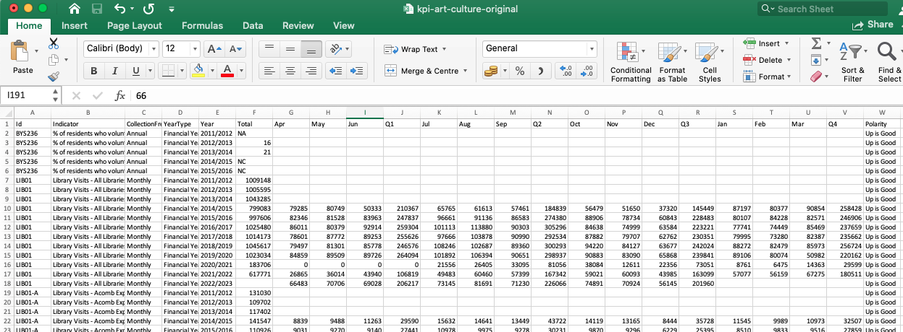
Collecting Data
kpi-art-culture.csv

Slide 8

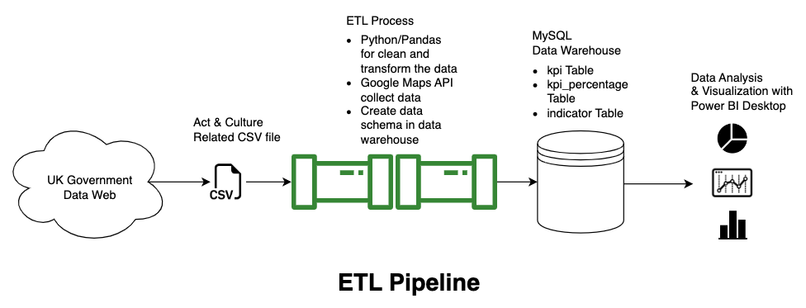
Project - ETL Pipeline & Data Visualisation

Slide 9
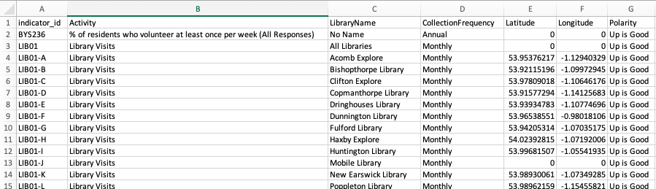
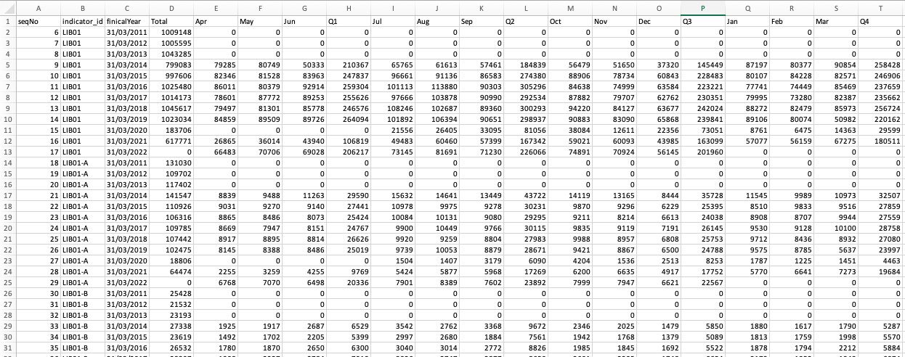
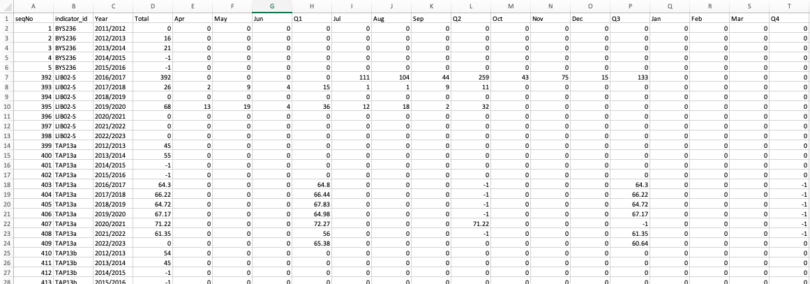
Files Stored to Data Warehouse
indicator.csv
kpi.csv
kpi-percentage.csv

Slide 10
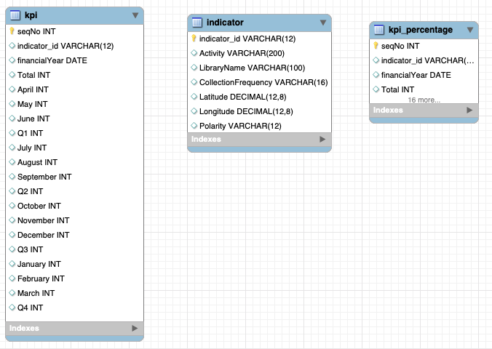
Files in Data Warehouse (MySQL)
kpi_percentage
indicator
kpi

Slide 11

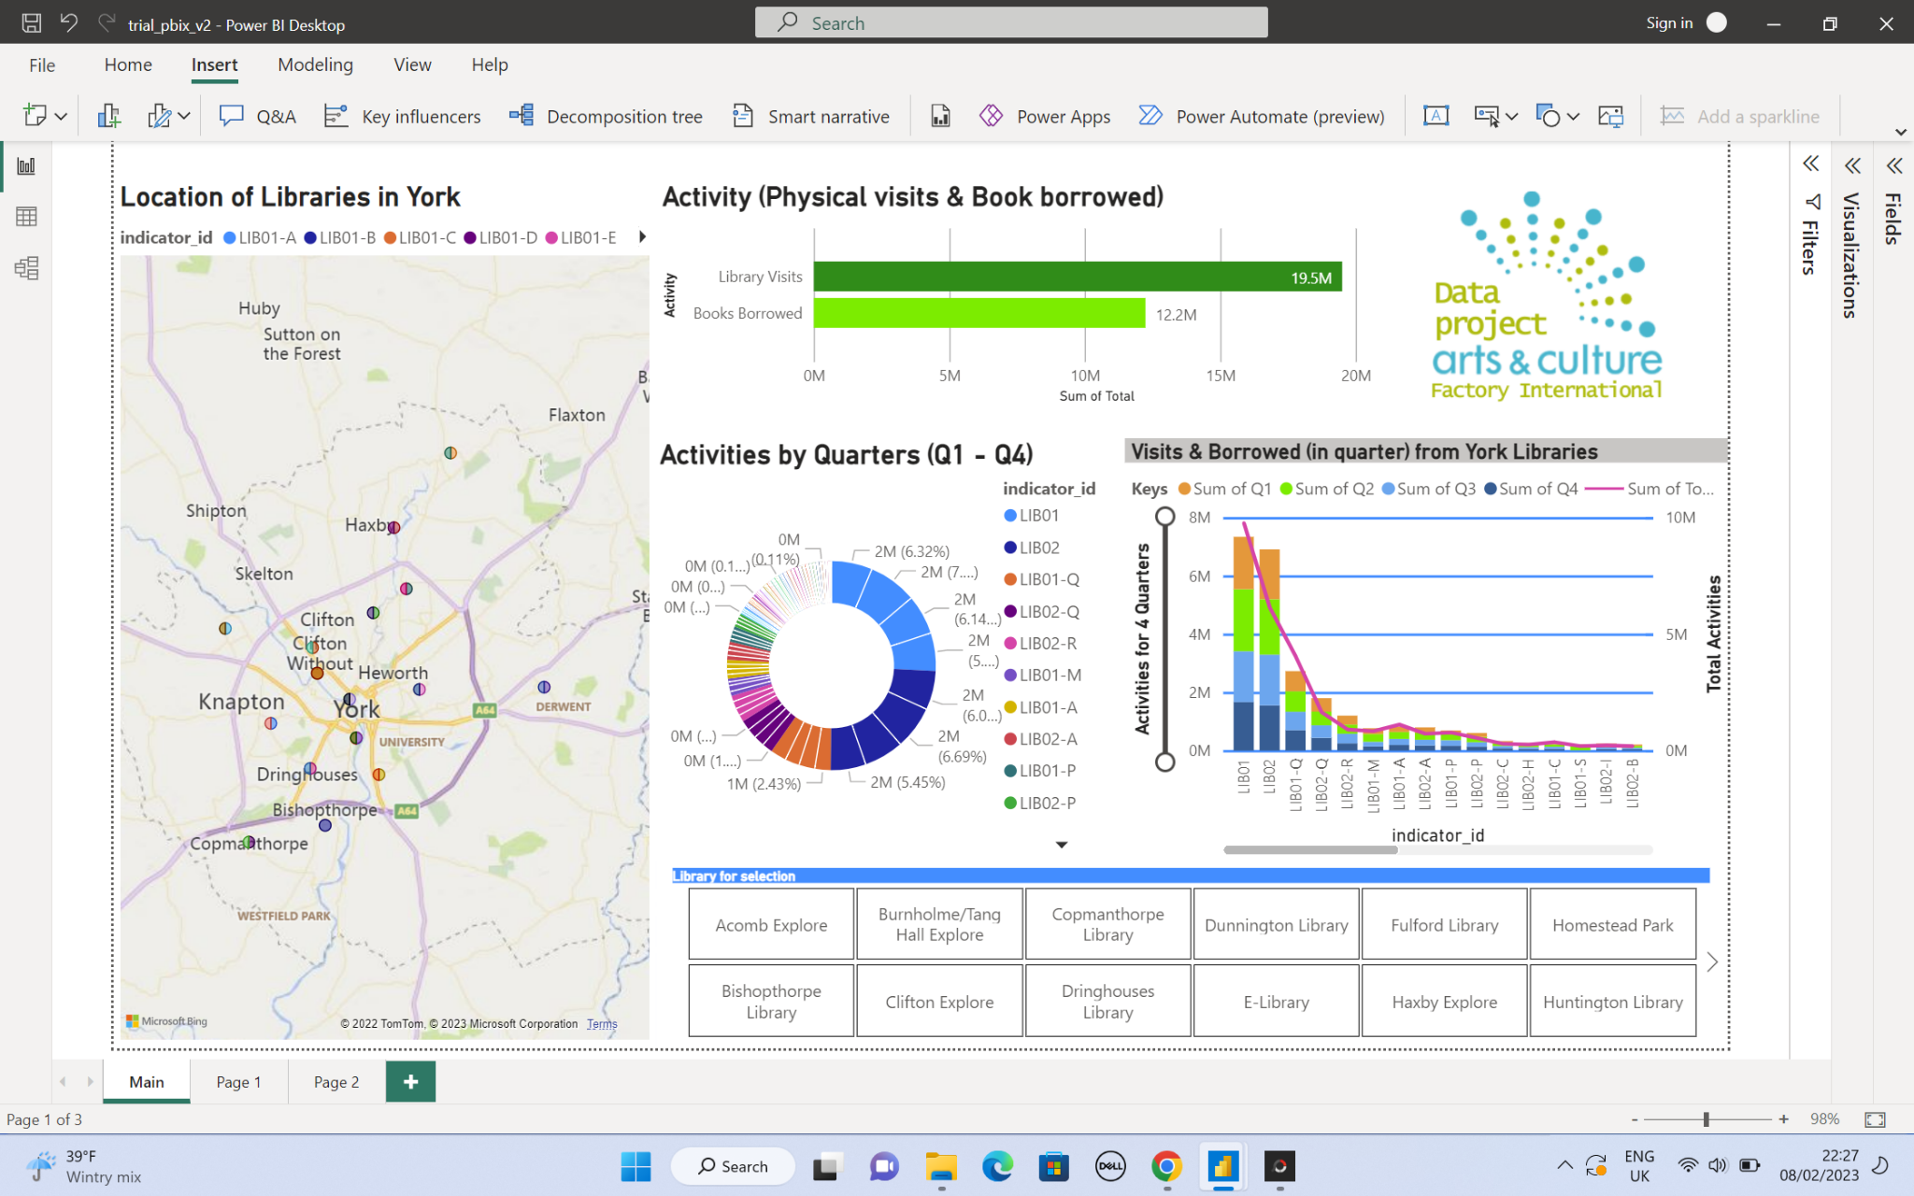
Analysis

Slide 12

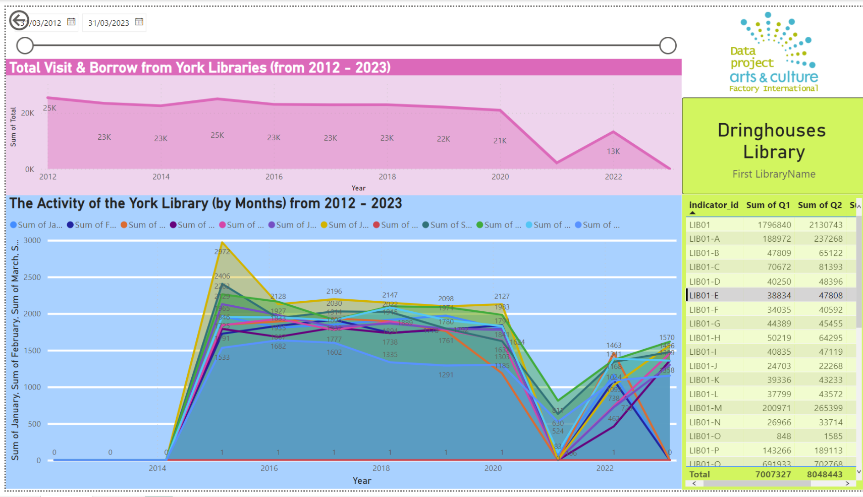
Analysis

Slide 13





Technologies Used
Python 3.11
Jupyter Notebook
Google Map API
MySQL Database
Power BI Desktop

Slide 14

Learning from the Project
Select the clean and reliable dataset to study (the most difficult part)
The exploratory data analysis techniques to build the ETL pipelines (Python, Pandas, API, Power BI & SQL)
Handling missing values in the dataset
Convert the corrected data format (Date format) for analysis
Remove the extreme value from the dataset
Performat the visiting analysis as well as the borrowed book behaviour
Add the coordinate location of the libraries by using the Google Maps API
Analysis and present the results

Slide 15
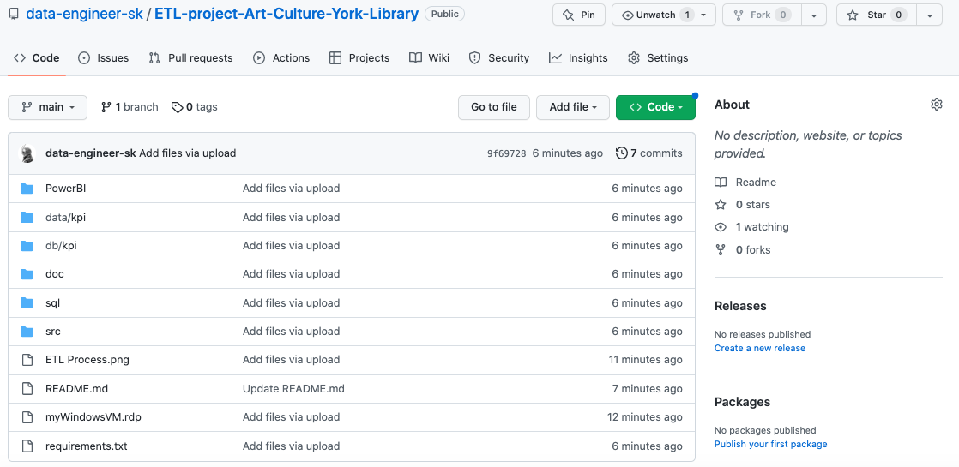

Source Codes and Files
Source Codes and Files are available in my GitHub

Slide 16

Thank You

